Slide 1

Query Millions of WGS Variants in Minutes with Azure Synapse

Slide 2
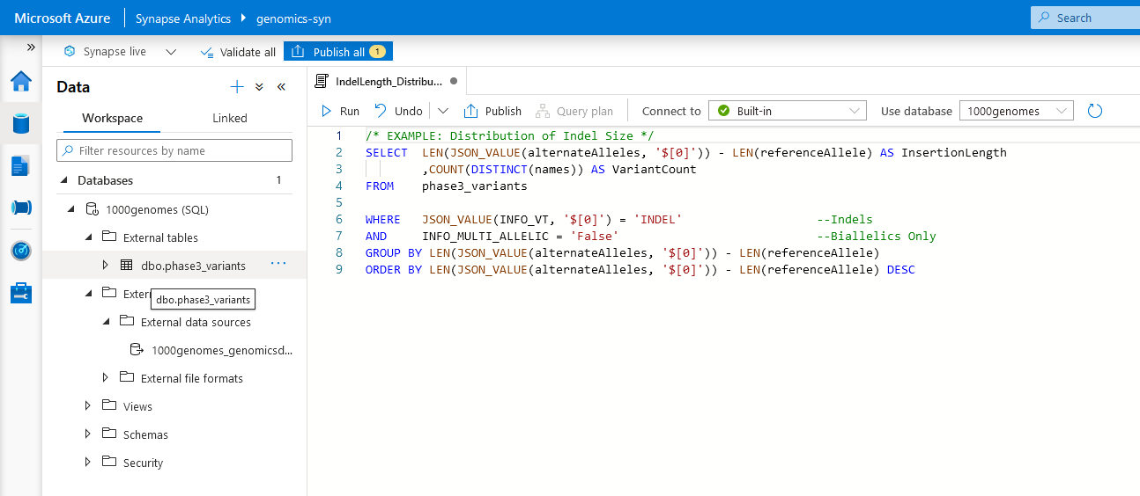
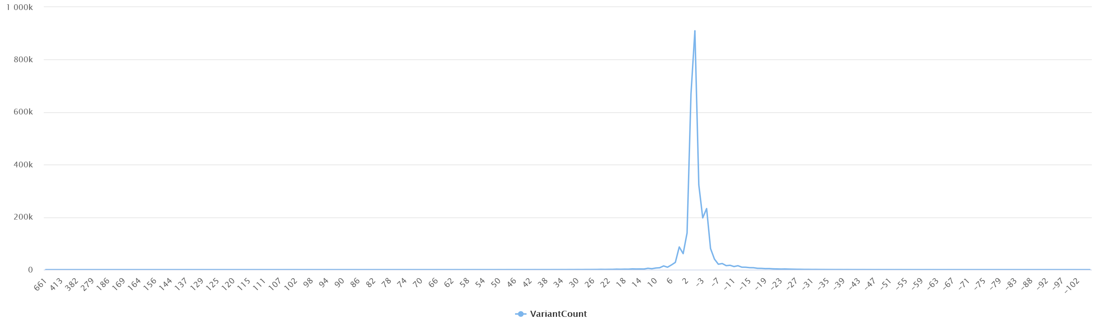
What’s Azure Synapse?
“Limitless analytics service with unmatched time to insight.”
Scalable analytics platform that includes Azure SQL Data Warehouse, Data Lake exploration, Apache Spark, integration with Power BI, and more.

Slide 3
Quick Data Stats
1000 Genomes Project
Phase 3
(GRCh38)
VCF File Size: ~168GB
Parquet File Size: ~75GB
80+ Million Variants
2,504 Individuals
Sudmant, P., Rausch, T., Gardner, E. et al. An integrated map of structural variation in 2,504 human genomes. Nature 526, 75–81 (2015). https://doi.org/10.1038/nature15394

Slide 4


Pipeline
Read in VCFs from
Data Lake in Apache Spark with Glow
Calculate Summary Statistics using Glow
Write out Data
to Data Lake
as Parquet Files
Create External Table
of All Variants in
Azure Synapse

Slide 5
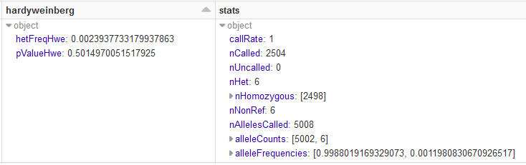
Converting VCFs to Parquet Files
(in 4 lines of code)
input_vcf_path = "/mnt/1000genomes/phase3_vcfs/chr1.vcf.gz"
output_parquet_path = "/mnt/1000genomes/phase3_parquets/chr1.parquet"
vcf_df = spark.read.format("vcf").load(input_vcf_path) \
.withColumn("hardyweinberg", expr("hardy_weinberg(genotypes)")) \
.withColumn("stats", expr("call_summary_stats(genotypes)"))
vcf_df.write.format("parquet").save(output_parquet_path)
+ 2 lines for some stats…

